Slide 1
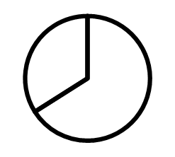
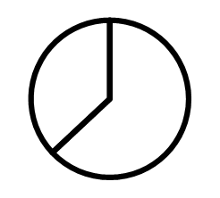
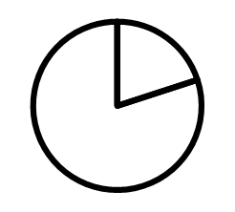
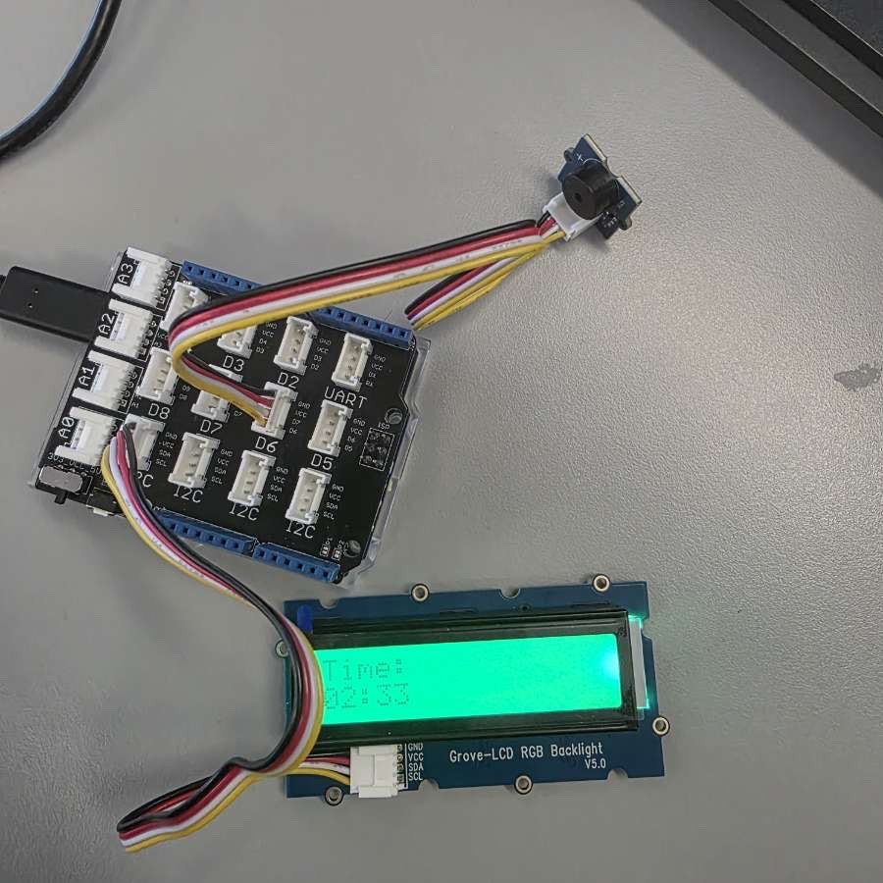
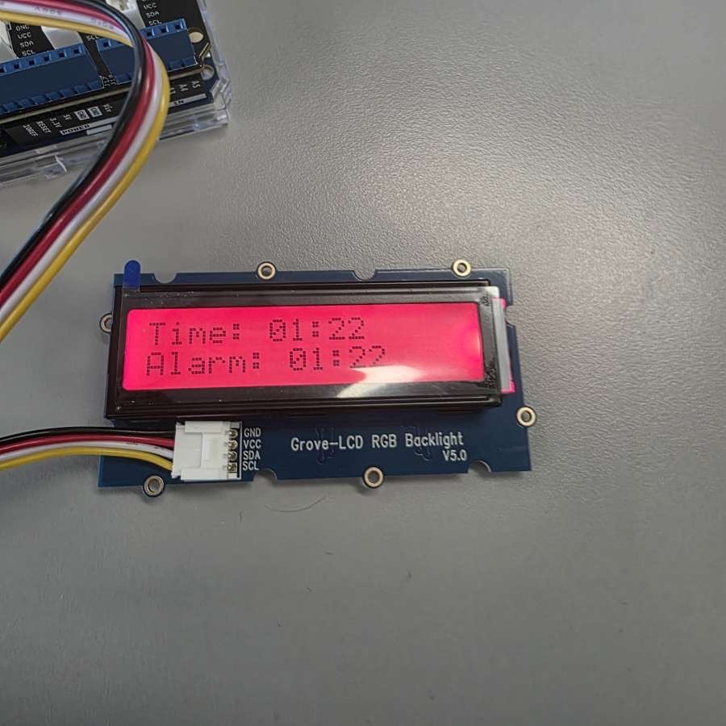
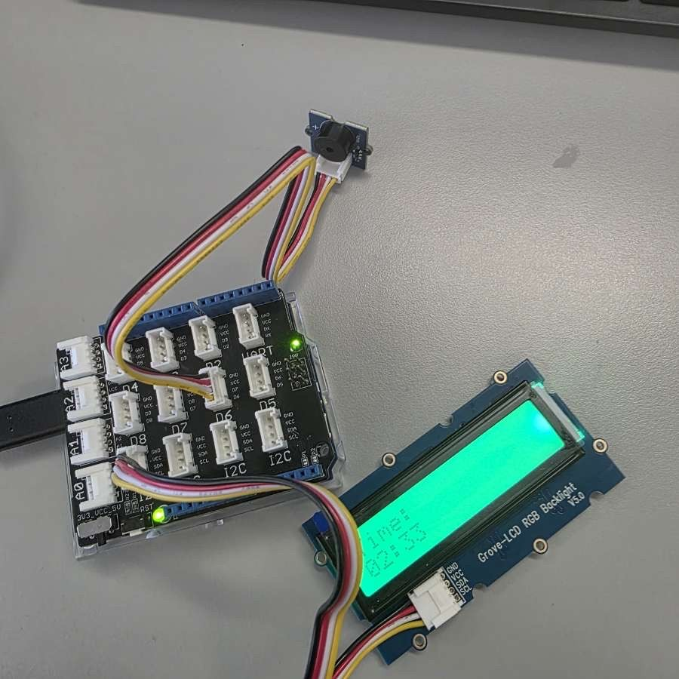
Arduino stopwatch Project 2026
stopwatch
By Cathy Finn, Eavirdas Puodziunas, Connor Brady, Kordian Mankowski
44%
Our stopwatch successfully performed all required functions
35%
66%
63%
20%
Start, stop,and reset were implemented using push buttons
1 arduino bored
Used as the main controller
3 input buttons
Controlled user interaction
Real-time Display
Time updated continuously on screen
This project focuses on designing and building a digital stopwatch using Arduino. The system allows users to start, stop, and reset time using buttons, while displaying the elapsed time in real-time. The project demonstrates practical applications of programming and electronics.
Arduion-based
system
Accurate Time
Tracking
A microcontroller was used to control timing and inputs
The stopwatch used code functions to measure time precisely.
This project helped develop skills in coding, circuit design, and teamwork. Challenges such as wiring errors and button sensitivity were overcome, resulting in a fully working stopwatch system
www.bellowscollege.com
info@bellowscollege.com
208 555 0100

